Slide 1


PACE program in Bedford MA
By Andres Correa Energy and Sustainability Manager

Slide 2


PACE Program introduction
MA Property Assessed Clean Energy Program (PACE).
Administered by MassDevelopment and Department Of Energy Resources.

Slide 3
Property Assessed Clean Energy(PACE)
PACE allows commercial property owners to finance energy improvements via betterment assessments.

Slide 4
Eligible Measures
Energy Efficiency
-Energy Management Systems
-Insulation and air sealing
-HVAC systems
-Boilers and furnaces
-Lighting
-Energy Recovery and redistribution systems
Renewable Energy
-Solar panels
-Solar hot water
-Geothermal

Slide 5
Eligible Properties
New and Existing Properties | Estimated properties In Bedford
Commercial/Industrial | ͌͌
Office Building | 29
Malls | 0
Hotels | 2
Restaurants | 27
Manufacturers | 14
Others (could fit in diff categories) | 44
Not For Profit | ͌͌
YMCA | 0
Schools | 4
Health Care | 3
Multifamily Housing | ͌͌
Apartment Complexes (5 or more units) | 2
Others | 14
Total | ͌͌͌ 139
Data aggregated From Assessment data base and Bedford Business info data base*

Slide 6
Key elements PACE MA
Can leave program at any time.
Maximum financing term allowed is 20 years.
Energy cost savings must exceed cost of improvements.
PACE obligation to pay stays with the property.
Retroactive consideration for installed improvements.

Slide 7
Key elements PACE MA
Capital Providers hold enforcement rights to pursue remedies in a default
-PACE cannot be accelerated (only unpaid billed assessment can be pursued in a default).
-Municipal liens are senior to PACE, and PACE lies is senior to private mortgage lien(s) in default.

Slide 8
Thanks

Slide 9
Appendix

Slide 10
Communities that adopted PACE MA
Acton
Agawam
Amesbury
Amherst
Ashburnham
Barnstable
Bellingham
Berlin
Beverly
Boston
Brockton
Brookline
Burlington
Cambridge
Chelsea
Chicopee
Clinton
Concord
Devens
Dudley
East Longmeadow
Easthampton
Easton
Erving
Fall River
Fitchburg
Franklin
Gardner
Gloucester
Grafton
Great Barrington
Greenfield
Hingham
Holyoke
Hudson
Lanesborough
Leicester
Lexington
Lowell
Ludlow
Lynn
Middleborough
Milton
Montague
New Bedford
Newton
North Adams
North Andover
Northampton
Norwood
Orange
Peabody
Pittsfield
Plymouth
Provincetown
Randolph
Rockland
Salem
Somerville
Southbridge
Springfield
Swansea
Taunton
Tyngsborough
Wakefield
Warren
Wellesley
Wellfleet
Wendell
Westborough
West Springfield
Weston
Winchendon
Woburn
Yarmouth

Slide 11
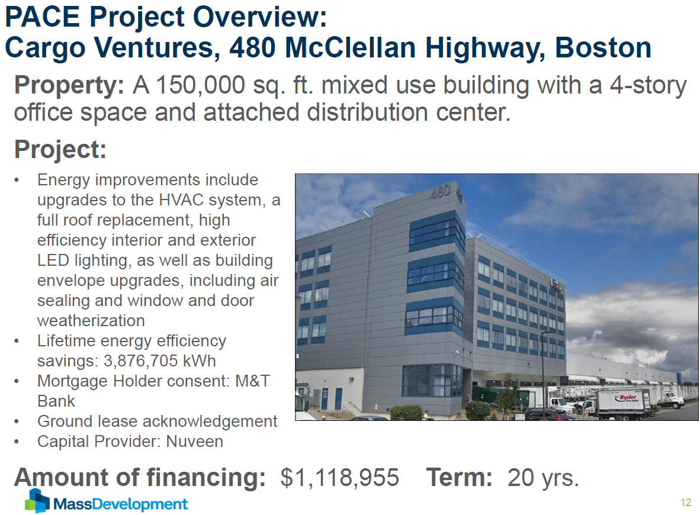

Slide 12
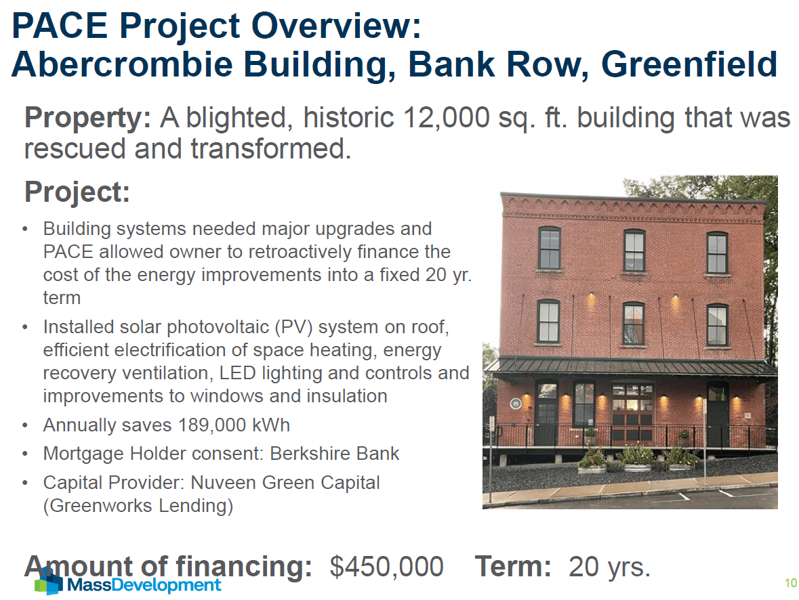

Slide 13
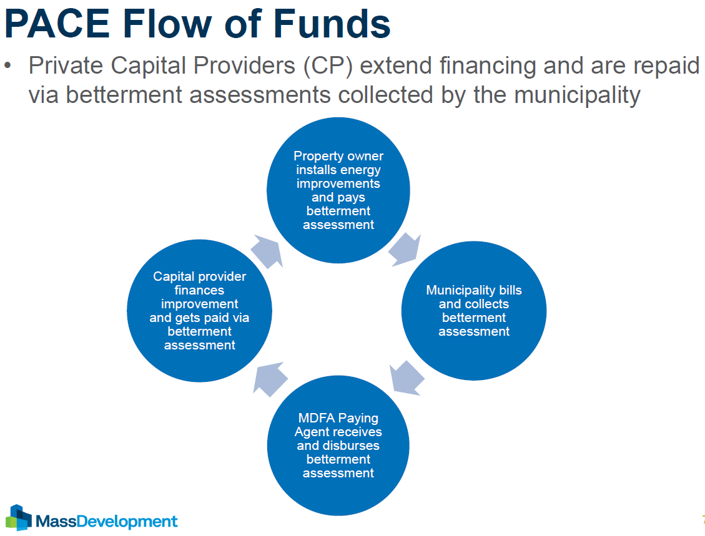

Slide 14
